Slide 1
TUnit
Embedded TinyOS
Unit Testing Framework

Slide 2
Topics
What is unit testing?
TinyOS Unit Testing Challenges
TUnit Framework

Slide 3
What is Unit Testing?
A procedure used to validate individual units of source code.
Units are:
  Entire Programs (large)
  Classes or Modules (medium)
  Individual Tasks or Functions (small)
The smaller the unit of isolation, the better.

Slide 4
Unit Testing Goals
Isolate parts of a program to show each individual portion works as intended.
Makes manual integration testing easier by verifying which individual parts work.
Verify code refactoring does not break previous test contracts
Verify an interface is implemented as intended.
Motivate developers to create decoupled and cohesive code bodies – modularize your code.

Slide 5
Unit Testing Limitations
Unit testing will not catch every error:
  Integration errors (modules/classes interacting with each other)
  Performance problems, including:
    Power tests
    Range tests
  Missing tests
Unit testing can only show the presence of errors; not the absence of errors.

Slide 6
Extreme Programming (XP)
XP is a test-driven software design, relying heavily on automated unit testing.
Philosophy:
  First design the architecture and interfaces.
  Write tests for those interfaces – those tests will fail.
  Write the implementations to make the tests pass.
This promotes thinking heavily about the program’s architecture before throwing down code.

Slide 7
Topics
What is unit testing?
TinyOS Unit Testing Challenges
TUnit Framework

Slide 8
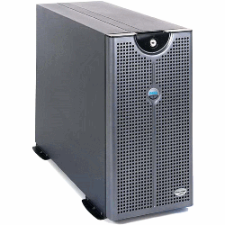
Standard unit testing (non-TinyOS)
Unit tests on a computer (i.e. JUnit or xPyUnit):
  One machine is used to run the tests
  Unit tests can be performed quickly
  System setup is relatively easy
  All tests are applicable to the project / test run

Slide 9
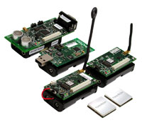
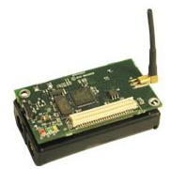
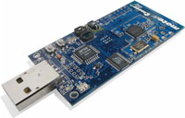
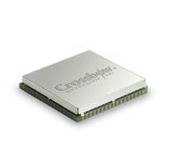
TinyOS Unit Testing Challenges
Unit tests on TinyOS:
  One or more nodes are used to run a test.
  One or more hardware platforms can be used
  Some tests may not be applicable to a given hardware configuration.
  Tests are run on both the embedded side and computer side
  Complex.

Slide 10
Previous TinyOS Unit Test Solutions
Previous philosophy: Don’t do unit testing on the actual hardware
Use TOSSIM, a TinyOS simulator, to run unit tests
nCUnit (nesC unit testing) – TinyOS v.1.x

Slide 11
Previous TinyOS Unit Test Solutions (cont.)
Advantages
  Ability to easily simulate wide scale networks
  Decouples from the embedded side
Disadvantages
  Don’t know if the code actually works on real embedded hardware if used on a simulator.
  Don’t know how different hardware platforms interact with each other if used on a simulator.
  Post-processing is required in some cases to determine whether or not a test passed or failed.
  Test beds are possibly bigger than the intended focus of unit tests.

Slide 12
TUnit Philosophy
Run all tests on actual embedded hardware
Take advantage of componentized software architecture to isolate unit functionality.
Organize tests in terms of Test Runs and Test Suites
  A test run is a single sweep of tests, with predefined hardware to test on.
  A test suite may or may not be applicable to a given test run.
Make unit testing a no-brainer so developers will want to write tests.

Slide 13
TUnit Philosophy (cont.)
Advantages:
  Test very small units of code in isolation.
  Run the tests on actual hardware, or groups of hardware.
  Run the tests on one or more hardware platforms.
  Automated regression testing and HTML reports.
  Supports RF and serial testing.
  Supports Java-enabled testing interacting with the hardware.
  xUnit method of unit testing
Disadvantages:
  Uses the serial stack to control the embedded-side test and pass results back.
    Increases test footprint size
    If the serial stack breaks, all tests break – but at least you know it.
  Memory footprint
    TUnit Embedded is about 6-7kB ROM, ~120 bytes RAM
    Most of that is the serial stack, which may be able to be replaced somehow

Slide 14
Topics
What is unit testing?
TinyOS Unit Testing Challenges
TUnit Framework

Slide 15
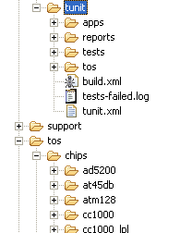
Setting up TUnit
Dependencies:
  Install Ant
    Ant is a build system using XML scripts to define build tasks.
    http://ant.apache.org/bindownload.cgi
  Define TUNIT_HOME
    Definition of the location where TUnit lives.
  Generate tunit.xml to define test runs
    Assumes you will connect your hardware once and leave it, as you would with automated regression tests.
  Include /support/make/tunit.extra
    Compile in tunit libraries

Slide 16
tunit.xml
Defines groups of test runs for TUnit to execute.
The first mote defined in each testrun is given address 0 and drives the test.
Every other mote has incremented addresses.
<tunit>
<testrun name="1_telosb">
<mote target="telosb" motecom="serial@COM22:tmote" installextras="bsl,21"/>
</testrun>
<testrun name="2_telosb">
<mote target="telosb" motecom="serial@COM22:tmote" installextras="bsl,21"/>
<mote target="telosb" motecom="serial@COM51:tmote" installextras="bsl,50"/>
</testrun>
<testrun name="micaz_and_telosb">
<mote target="telosb" motecom="serial@COM51:tmote" installextras="bsl,50"/>
<mote target="micaz" motecom="serial@COM11:micaz" installextras="mib520"/>
</testrun>
</tunit>

Slide 17
TUnit Directory Setup
The modules you’re testing exist outside of TUnit.
Tests are located inside the tunit/tests/ directory
Tests are prefixed with the word “Test”
  i.e. “TestActiveMessageC”
Each test suite has its own directory

Slide 18
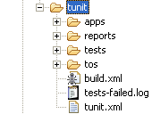
TUnit Directory Setup (cont.)
TUNIT_HOME base directory
TUnit supporting applications
TUnit HTML reports and archives
All TUnit tests
TUnit supporting libraries
Ant build script
Failures from the last test run
Test run configurations

Slide 19
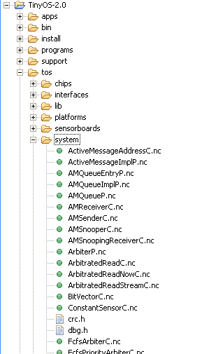
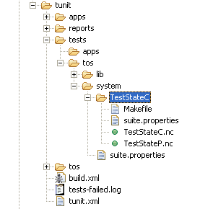
TUnit Directory Setup (cont.)
Want to test tinyos-2.x/tos/system/StateC?
=> Create a suite for it in tunit/tests/tos/system/TestStateC
Next time TUnit is run, TestStateC will be executed.

Slide 20
suite.properties files
When TUnit is traversing directories, it looks for suite.properties files.
A single suite.properties file is applied to all sub-directories
Multiple suite.properties files can be aggregated together as TUnit traverses into sub-directories.
Suite.properties tells TUnit how to decide if the given test is applicable to the current test run.

Slide 21
suite.properties example
/**
* Valid keywords are:
* @author <optional author(s)> (multiple)
* @testname <optional testname> (once)
* @description <optional, multiline
* description> (once)
* @extra <any build/install extras>
* (multiple)
* @ignore <single target> (multiple)
* @only <single target> (multiple)
* @minnodes <# nodes> (once)
* @maxnodes <# nodes> (once)
* @exactnodes <# of exact nodes> (once)
* @mintargets <# of minimum targets for
* heterogeneous network testing> (once)
* @timeout <timeout duration of the test in
* minutes, default is 1 min.>
* @skip (once)
*/
@testname Test StateC
@author David Moss
@description Tests some different boundaries of the State component. We may need some more tests to cover all the cases, like atomic state changing.
@exactnodes 1

Slide 22
TUnit Execution
Find and parse tunit.xml
Traverse directories, gathering suite.properties files and finding tests to run
Compile each applicable test application
Install the test application
Run the test, wait for the test to complete
Write the results of each suite to an XML file
Generate HTML reports
Archive reports
Alert developers

Slide 23
Embedded-side TUnit
TUnit provides several interfaces based on xUnit:
  TUnit (main test interface)
  SetUpOneTime
  SetUp
  TearDown
  TearDownOneTime

Slide 24
Embedded-side TUnit
Order of execution:
  SetUpOneTime (also the only interface that is run on secondary nodes)
    SetUp
      TUnitTest1.run()
    TearDown
    SetUp
      TUnitTest2.run()
    TearDown
  TearDownOneTime

Slide 25
Embedded TUnit Interface
interface TUnit {
event void run();
command void done();
}
assertEquals(char *failMsg, <typedef> val1, <typedef> val2);
assertNotEquals(char *failMsg, <typedef> val1, <typedef> val2);
assertTrue(char *failMsg, condition);
assertFalse(char *failMsg, condition);
assertNull(void *pointer);
assertNotNull(void *pointer);
fail(char *failMsg);
success();

Slide 26
Embedded-side TUnit
Setting up your test configuration
configuration TestStateC {
}
implementation {
components new StateC(),
TestStateP,
new TUnitC() as TestForceC,
new TUnitC() as TestToIdleC,
new TUnitC() as TestRequestC;
Give each test a name!
Each test uses a new TUnit component.

Slide 27
Embedded-side TUnit
Example of a single test
event void TestForce.run() {
call State.forceState(S_STATE1);
assertTrue("TestForce: S_STATE1 not forced
correctly", call State.getState() == S_STATE1);
call State.forceState(S_STATE2);
assertEquals("TestForce: S_STATE2 not forced
correctly", call State.getState(), S_STATE2);
call State.forceState(S_IDLE);
assertFalse("TestForce: State was supposed to be
idle", call State.getState() == S_STATE3);
call TestForce.done();
}

Slide 28
Running TUnit
Run all tests
DEV@LAP4 /opt/tinyos-2.0/programs/tunit
$ ant
<Find all applicable tests>
<Compile for each testrun-defined platform>
<Install to all testrun-defined hardware>
<Write XML reports>
<Repeat for each directory>
<Repeat for each test run>
<Produce reports and archives>
<Notify developers>

Slide 29
Re-running TUnit
Rerun only tests that failed
DEV@LAP4 /opt/tinyos-2.0/programs/tunit
$ ant tunitrerun
<Find previously failed tests>
<Compile for each testrun-defined platform>
<Install to all testrun-defined hardware>
<Write XML reports>
<Repeat for each directory>
<Repeat for each test run>

Slide 30
TUnit Results
Command line results
[java] T-Unit Results
[java] -----------------------------------------------
[java] Total runtime: 147.049 [s]
[java] Total tests recorded: 21
[java] Total errors: 0
[java] Total failures: 0

Slide 31
TUnit Results
Command line failures
T-Unit Results
-----------------------------------------------
Total runtime: 18.564 [s]
Total tests recorded: 1
Total errors: 1
Total failures: 0
__Build telosb tunit (ROM=0; RAM=0) (Compile Error): make: Entering directory `
/opt/tinyos-2.0/programs/tunit/tests/tos/system/TestFifoQueueC'
mkdir -p build/telosb
compiling TestFifoQueueC to a telosb binary
ncc -o build/telosb/main.exe -Os -O -mdisable-hwmul -Wall -Wshadow -DDEF_TOS_AM_
GROUP=0x7d -Wnesc-all -target=telosb -fnesc-cfile=build/telosb/app.c -board= -I%
T/../programs/tunit/tos/lib/tunit -I%T/../programs/tunit/tos/system/ -I%T/../pro
grams/tunit/tos/interfaces TestFifoQueueC.nc -lm
make: Leaving directory `/opt/tinyos-2.0/programs/tunit/tests/tos/system/TestFif
oQueueC'
In file included from TestFifoQueueC.nc:6:
In component `TestFifoQueueP':
TestFifoQueueP.nc: In function `TestBadDq.run':
TestFifoQueueP.nc:100: implicit declaration of function `assertFalse'
make: *** [exe0] Error 1

Slide 32
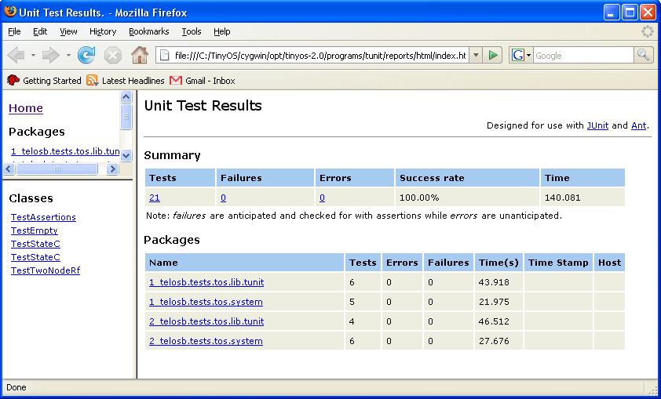
TUnit Results

Slide 33
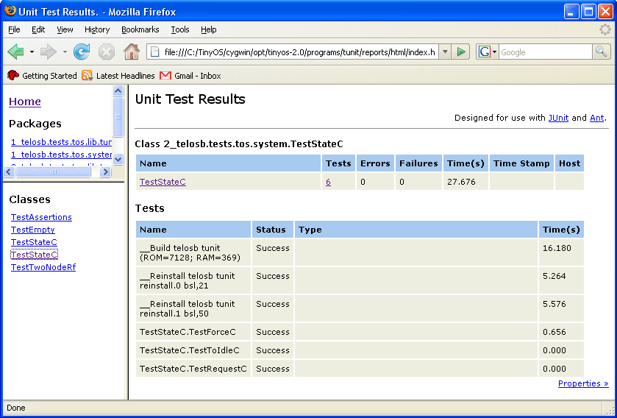
TUnit Results
Test names are automatically extracted from app.c and mapped to assertions made within your embedded application.

Slide 34
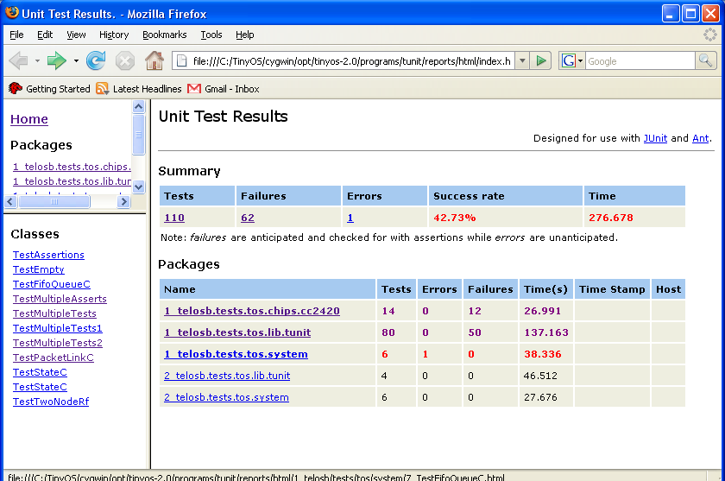
TUnit Failures

Slide 35
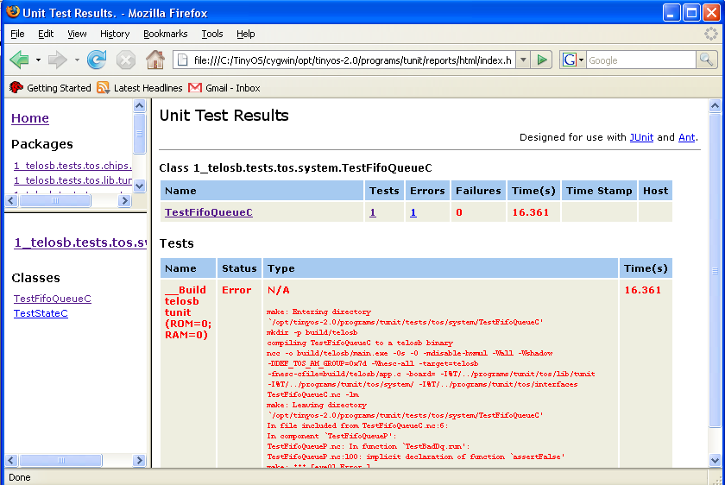
TUnit Failures

Slide 36


TUnit Results
Alert Developers
  Automatic emails
  Wireless Lava Lamps (found in /tunit/apps/)
  Smoke machines powering up inside the server on failures
  Easy bake oven begins making brownies on success
SUCCESS!
FAIL.
http://www.pragmaticprogrammer.com/pa/pa.html

